Slide 1

Housing - Price Prediction

Slide 2
This dataset is about housing price prediction in US as one of the real Estate company wants to start business in US , so before starting wants to know the market trend of how customer are and what is the recent trend being followed in that particular market. Having own house is the need or necessity of every person around the globe and because of this real estate business are in boom, and the major contributor towards world’s economy. Hence lot many companies are in this domain which in result competition is high . Data scientist job role is here to find out the market trend and what strategy to follow or if already designed then what improvement is required so that a company can generate good revenue, will earn higher profit and loss chances would get decreased, and focusing on trends being changing with time in sale and purchase of house. This will not only help in getting idea on what to focus and what type of customer do market have. What new trend being followed. Recommendation of what maket to focus, will help the company to take their decision and initiate accordingly . This will not only help them to build a good strategy but also will able to focus on a particular area where they can achieve their goal. Data scientist is playing a vital role by predicting the future sale or purchase price of houses using previous data with the help of their domain knowledge using machine algorithm.
Problem Statement And Understanding

Slide 3
Explanatory Detailed Analysis - EDA
This dataset is all about housing price prediction in which our target column is Sales price i.e., dependent variable and rest 80 columns are independent variables on the basis of which will going to predict whether to invest in such properties or not. Both train and test dataset been provided. On the basis of train dataset will train the model and finally will do prediction while on test dataset where no target column been provided, that we need to predict after saving the model . But in test dataset too we need to do data cleaning, feature engineering, removal of skewness, outliers. After following all these process will just predict on the basis of this. So here In train dataset total no of rows were 1168 while no of columns were 81 including target column. While in test dataset total no of rows were 292 and columns 80 because no target columns are there in test dataset. To check the data types used info method where able to recognise that how many object columns are there, as we know that our machine algorithm not able to understand object or string form so we need to convert them to integer form using feature engineering. Total object columns present are 43 and integer or float data types are 38. Came across insight that there are 43 columns which are even categorical column too, even there are few discrete columns means though they are in numerical form but not continuous in nature. Next coming to statistical part of data, came across that there are lot many missing values present. And even some of the columns are there which are skewed means not falling under normal distribution and even outliers are there which means those data points which are out of border and unusual. So I used mean to treat continuous columns missing values as mean takes average of data points and replace nan with the same. For categorical columns used mode method as mode replace nan value with that data point which being repeated more number of times. After doing data cleaning did feature engineering so that our model could understand each column and can predict more accurately. For converting object to integer form used label encoder as it returns value in numeric form and number of columns not get increased, while using one hot encoder which we mainly prefer for categorical columns no of columns get increased which in turn increases the size of our dataset. So to avoid such issues used label encoder. Then removed skewness using log 1p as it is near to 0 which is good for our model prediction , then removed outliers using z-score. Dropped those columns whose missing values were more than 50% to avoid multicollinearity issue. After treating all the requirements which were needed for our model to perform in a better way scales all the feature columns of train dataset for model prediction. For more better insight of data used visualisation technique using matplotlib and seaborn in next slide.

Slide 4
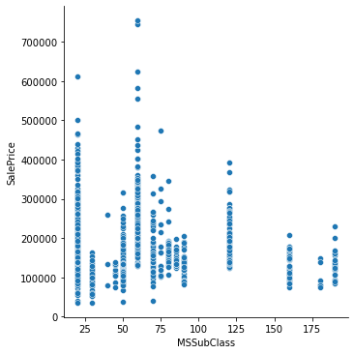
Visualisation Analysis
MS subclass means type of dwelling for sale , here with the help of relplot we can see that dwelling 20 and most probably 60 are having higher sales value .
Where 20 stands for 1-STORY 1946 & NEWER ALL STYLES and 60 Stands for 2-STORY 1946 & NEWER . From this we can conclude that mostly higher price are for those residents which are either 1 storey or 2 storey which was constructed in 1946 means more antic also we can assume that usually those time materials used for the construction of houses were really having more durability and longitivtiy due to which customer are preferring and prices are higher for these properties while newly constructed building will definitely be in demand as no need to renovate and new style and updated designs being used while construction. Also longitivtiy will be more compare to older one

Slide 5

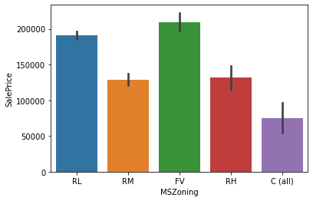
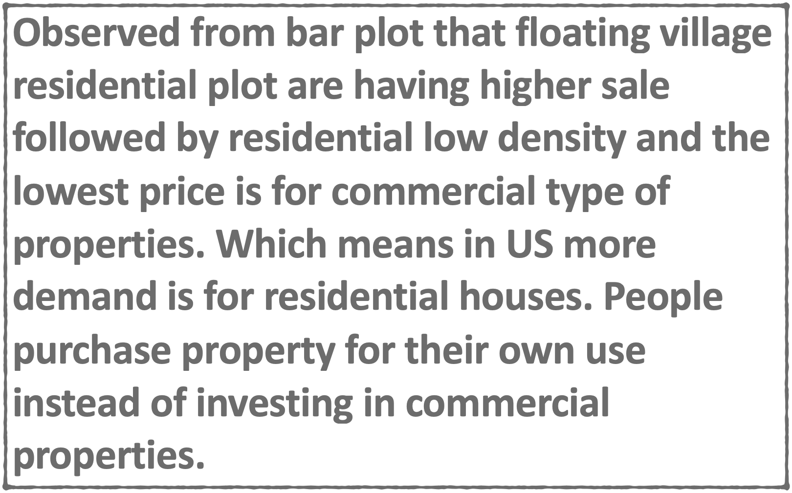
Zone Wise Analysis

Slide 6
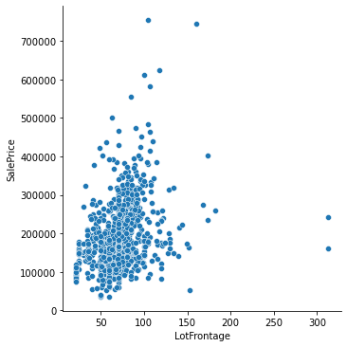
Linear feet of street connected to property
Mainly higher selling price we can observe that lotfrontage i.e., linear feet of street which is between 50 - 100 ft are having higher and range between 1lac to 4 lac, so here street which is connected to property from 50-100ft are more in demand. But some points we can see that even reached to 6 lac and 7 lac which is unusual as the pice trend followed in market for 50-100 ft road is within 4 lac. With this we can say that there are outliers present in this column.

Slide 7
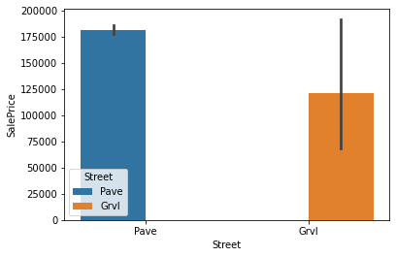
Type of Road access to Property
With the help of barplot we can clearly observe that pave type are having higher demand compare to GRVL as for pave type of road which is near by to property even shown the highest sales till 1.75 lac while for Grvl type we can see that maximum price reached upto 1.25 lac. With this we can consider that pave type is being more preferred by residents of US so the demand is high

Slide 8
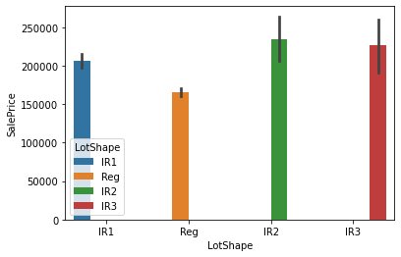
General shape of Property
Moderate irregular and irregular shape of houses are having higher sales price . Which means mostly in demand are these type of shapes of houses. Any company who are investing in these market should have in mind what is preference and which type of property are having higher selling price.

Slide 9
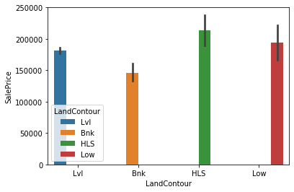
Flatness of the Property
Landcounter which means flatness of the property. Here we can see that property which are having significant slope from side to side are having higher price value. While properties which are banked flatness which means quick and significant rise from street grade to building are having low selling price . So with the prospect of investment in property a builder can purchase these types of properties and can sell by seeing the market trend and demand for such houses in future.

Slide 10
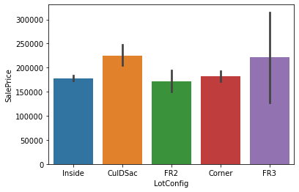
Lot Configuration
Cul-d-sac and frontage on 3 sides of properties are having higher selling price while properties with 2 sides of frontage are having low price which is below 2 lac . Market trend we can say that investment should be done on FR2 and if any builder is having FR3 and CulDsac type of lot configuration then they should try to sell them in the market as return for the same is pretty high almost above 2 lac.

Slide 11
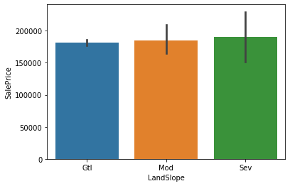
Land Slope of Property
As we can see that slope doesn’t affect much the property rate. Almost all are under same label i.e., above 1.75 lac approx . Still properties adjacent to severe slope are having slight difference and little higher price compare to other two

Slide 12

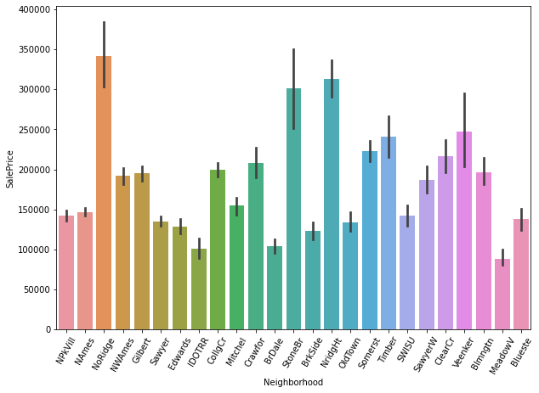
Text(24, 0, 'Blueste')])
Land Slope of Property
With the help of barplot we came across that cities which are within the range higher selling price are for North Ridge , Stone Brook, Northridge Heights which are having sales price above 3 lac. While lowest selling price is for meadow village. May be the price is low because of less accessibility or may be far compare to those neighbour cities which are having higher price. Neighbour cities which are developed and having more developing cities are higher in demand which may cause in increase of sales of properties.

Slide 13

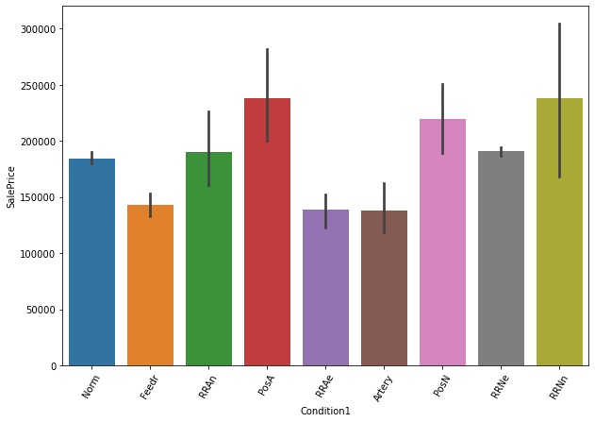
Proximity to various condition - condition1
PosA which means properties which are adjacent to positive off-site feature and properties with 200 or north-south railroad are having higher selling price. This we can assume that either due to demand or area where the property located are in demand so the price for the same is high which is almost 2.5 lac. While there are three conditional properties which are having low price compare to others . They are RRAe I.e., east-west railroad, Artery i.e., adjacent to arterial street and normal.

Slide 14
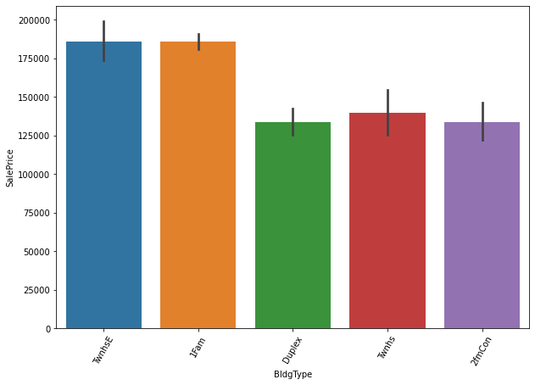
Type of Dwelling
As in US most of the trend is for nuclear family , so we can say that 1 Farm which means single-family Detached type of dwellings are having higher price value while Townhouse end unit too have higher price. These type of dwellings are in more demand so the price for the same are high. As an investment purpose company should focus when the price falls for these properties they can purchase and secure the same for future sale.

Slide 15

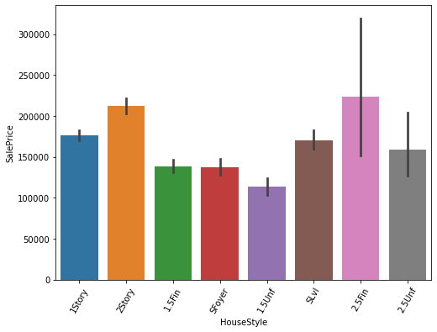
Style of Dwelling
Mostly two and one half storey : 2nd label finished properties are having higher price which is approx more than 2.2 lac . While 2nd label unfinished types of dwelling are having very low price comparatively which is around 1 lac. So the people of US may be preferring one and a half story building with 2nd label finished type of dwelling so the price are higher for the same.

Slide 16

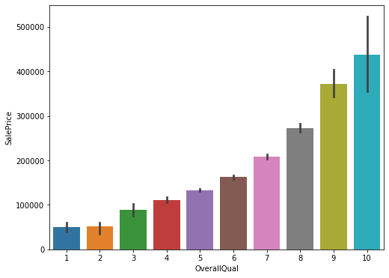
Overall material of the rates and finish of the house
Material and finishing of houses for which rating being given 10 which means very excellent material and finishing used for house. Selling price definitely will be higher as we know that how good the material is that much higher the price will be. As an investor one should focus on material being used in houses and how the finishing of the properties are

Slide 17
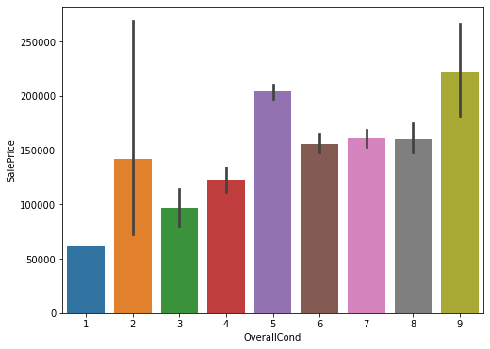
Overall Condition of the house
Even rating which being used 9 are having higher price which is obvious. Price depends upon the condition of houses specially for old houses. How well the condition of house be maintained price for the same price will definitely be high due higher demand

Slide 18

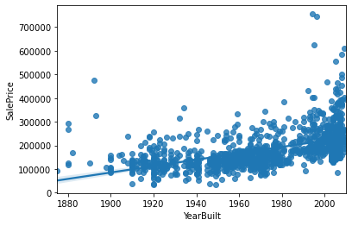
Original construction date
With the help of relplot we can see that price for those properties are higher which are built after 2000 even one more interesting insight we can see that more recent constructed properties are having higher price value so from 1900 to 2000 there are no decline in price with the passing year. But we can see few of the points which are out of boundary which is considered as outlier

Slide 19
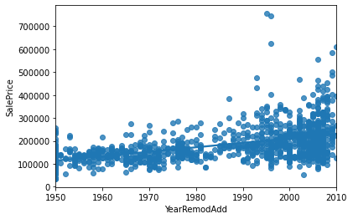
Original construction date
With the time every house needs maintenance and renovation. So here we wants the insight of whether recent remodel houses are having good demand and selling price in market . And what we see is most recent remodelled houses which are in 2010 are having almost selling price upto 4 lac while properties which not being remodelled or very old renovation done are having very low selling price. We can also imagine that if a house not being renovated on time their condition will not be in good position and none of the buyers wants to reinvest in renovation after purchasing old properties as it increases the budget. Even in construction also we seen that most recent houses are having higher value which is almost 4 lac so similar to remodelled properties .

Slide 20

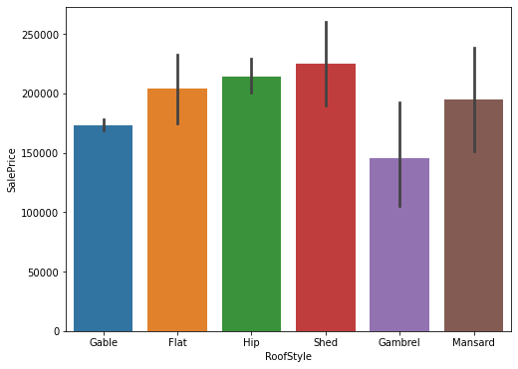
Roof Style - Type of Roof preferred
Shed roof style are having higher price value which is more that 2 lac. In US we can say that mainly demand is for this type roof style. As we know that if demand be higher price will definitely be high .And lowest price is for Gamble roof style. Investor should look into these factors and should invest accordingly so that they don’t have to face any loss in future after investing in any property.

Slide 21

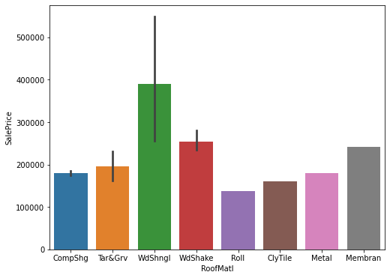
Roof Material of the Property
Wood Shingles are mainly in demand as the price for these type of roof material which being used while construction are having higher selling value which is almost 4 lac. Rest all are even below 2.5 lac. High means WdShngl type of material for roof are superior and are having higher value in market.

Slide 22
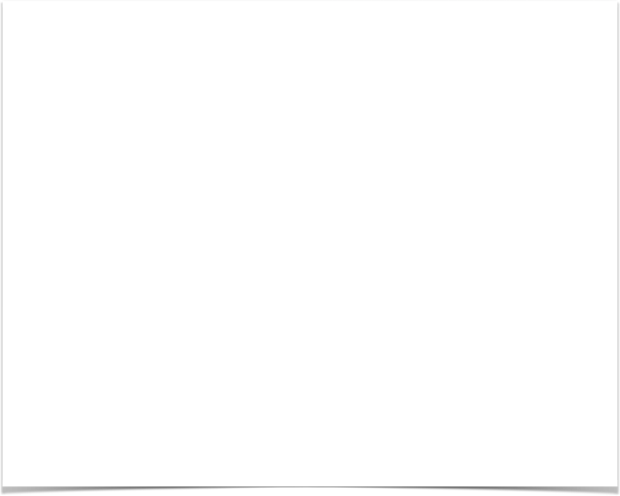
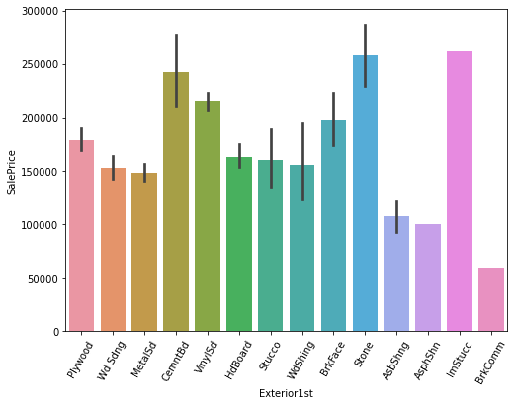
Exterior Covering on House
Exterior covering of houses being done with stone and imitation stucco are having higher selling value while common brick being used for exterior of houses are having very low price in the market. Again preference and demand rises the price for anything . Same is the case here as we know that stone and imitation Stucco are not only durable but also looks pretty which brings the look of house. And as good and durable the house will be, price for that will be higher in market.

Slide 23

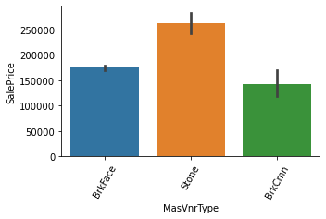
Masonry Veneer Type
As we seen in exterior covering of houses too stone covered exterior were having higher sales value same in masonry veneer we can see that build with stone are having higher selling price which is almost 2.5 lac. Rest all are below 2 lac. So stone preference are higher there and that to be considered as premium one.

Slide 24
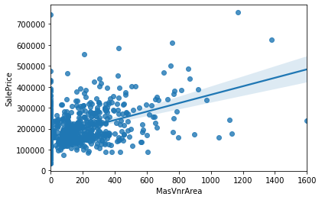
Masonry Veneer Area
Masonary vaneer mainly sold out between 50 - 400 sft area while there are few points which are showing very range which is unusual and we consider it as outliers . Data which are our of range. The area mentioned above having selling price between 1 lac to 3 lac. But one more things we can see is it doesn’t matter whether it’s 100 sft or 400 sft almost price graph showing same. It may be considered that depends upon the type of property and area where the property is price varies.

Slide 25
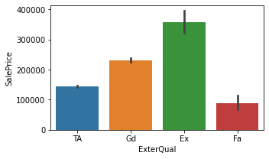
Quality of Material on the Exterior
Here quality of material being used excellent is having higher sales value which is obvious while fair quality used material are having very low price which is 1 lac. In quality no one wants to compromise. Still if compromisation is there which is because of budget which we can see in average / typical whose price is comparatively higher than fair one .

Slide 26
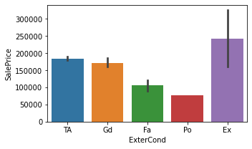
Present condition of the Exterior
If we use good quality material condition of houses varies accordingly. As a result we can see here with the help of barplot that material which is of excellent quality used during construction for exterior showing higher price value which is unmatchable from other quality being used and poor quality used will definitely not give much return as the condition of house will not be so good and the same we can see through our bar plot that poor material used properties are having price range within 50 - 60 thousand which is very low. Price for those houses which were newly constructed and whose material being used excellent were 4 lac while for older one too there not much difference in price . 2.5 lac price being showing for repurchasing houses with such a used material.

Slide 27
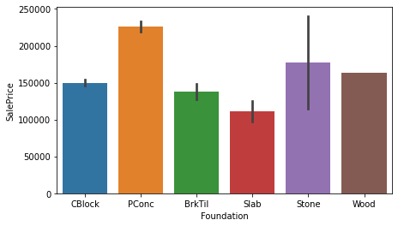
Type of Foundation
What type of foundation being used while constructing the house matters during sale as type which is more in demand will have higher price value. During purchase of property customer looks after every aspect and then they pay accordingly as per the market trend and whether all the required demands being fulfilled or not. Here poured concrete are having higher sales value which almost touching 2.5 lac showing in bar plot while lowest price is for slab which is slightly higher than price range of 1 lac

Slide 28

Basement Analysis

Slide 29
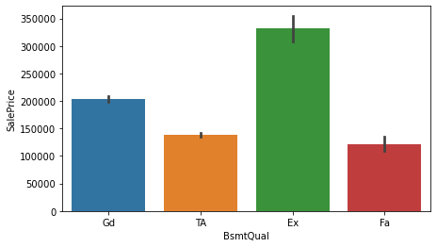
Evaluating Height of the Basement
Height of the basement being rated excellent which ranges between 100+ inches are having higher sales value which is almost above 3 lac. While basement height ranges from 70 - 89 ft which is for typical/ average and fair are showing very low selling price in market which is below 1.5 lac

Slide 30
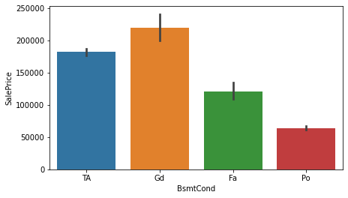
General condition of the Basement
Basement which are in good condition means no dampness or crack are having higher value in market while with little crack or dampness is also fine as the price difference between good and average is slight . While with poor condition id having very low price which is obvious. Whoever buy such property with poor quality of basement they again have to invest in renovation .

Slide 31

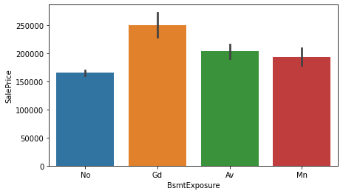
Basement Exposure
Basement exposure which here refers to walkout or garden level walls. So here with good exposure having selling price upto 2.5 lac while no exposure are having price upto 1.6 lac. We can assume that demand for walkout area is higher and more person invest in such properties which is having such kind of facility even though it’s minimum but buyers prefer this area.

Slide 32
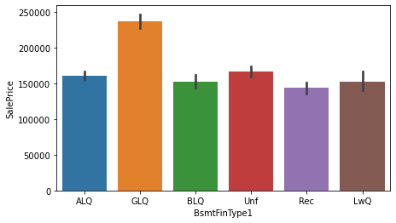
Basement Finished Area Rating
Most of the basement generally have a small living area which being used by watchman of the property or for any other purpose if watchman is not there. Here with the help of barplot we can see that good living quarter is having higher price value which is almost 2.5 lac while rest all are not having much variance in price.

Slide 33
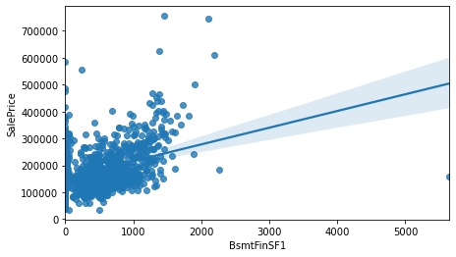
Basement Finished square feet 1
Area built up from 100 - 1000 sft are having price ranges from 1 lac to 3 lac for type 1 finished basement. While there are few points which even crossed 5 lac and reached upto 7 lac which is very unusual as most of the data points lie between 1 - 3 lac so I am considering such points as an outliers which we need to remove using different outliers technique

Slide 34
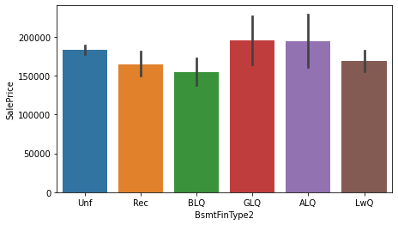
Rating of Basement Finished Area - Multiple Types
If there are various option for types of quarter available in basement for living purpose we can see that price variance do have slight difference. Good and Average living quarter are still having price range higher compare to other type of living quarter which ranges within 1.5 lac

Slide 35

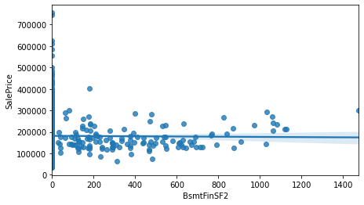
Basement Finished Square Feet - Type 2
In type 2 we can see that almost the line is flat means no such variance in price. While most datapoints are ranging from 50 - 700 sft and price for the same is completely flat that is within 2 lac , While in type 1 we seen that upto 1000 sft price reached upto 3 lac. One reason may be that in type 1 almost most of the area being covered so in type 2 few of the area being added and so the price variance is not much

Slide 36

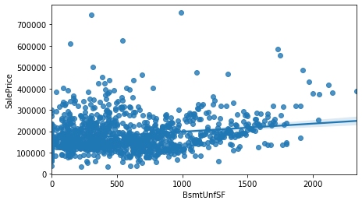
Unfinished square feet of Basement Area
Unfinished means not completely finished area which we can see is having higher price value for area ranging from 100 - 1000 sft which is upto 3 lac. Same price range and sft area we observed in type 1 finished basement area . That means even unfinished area are also in demand just the area range should be equal to fished area range. Eve here sold area upto 1500 sft whose price range also was between 2 - 3 lac. Which may be depending upon what is condition of basement that means how much area is unfinished and need to work on the same . While in this column too there are few outliers.

Slide 37

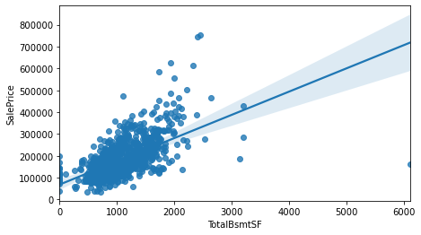
Total Squarefeet of Basement Area
Total sft of basement area being considered from 500 - 2000 sft and price even ranging from 1 lac - 4 lac. Here price range is becoming higher with every increasing area. So we can see the positive correlation between price and area being constructed. That means price varies according to the area being used for basement

Slide 38

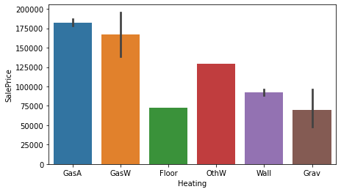
Types of Heating used in houses
Gas A which means gas forced warm air furnace are having higher price value which is almost 1.75 lac followed by gas forced for warm water furnace. Both these types of gases are having higher demand so the price is high. While floor furnace is in lowest demand , considering this by seeing the selling value for the same which is within 75 thousand.

Slide 39

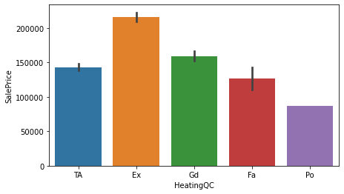
Heating Quality and Condition
As quality matters for everything same we can see here that excellent quality of heating do have higher sales value while lowest is for poor which is near about 1 lac and this is obvious.

Slide 40

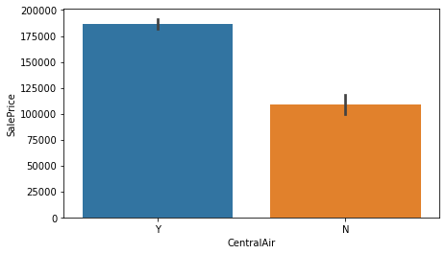
Central Air Condition
Houses having central air condition are having higher sales value. Along this facility the demand for property increases which is almost having price value crossing 1.75 lac while those properties not having this facility is having value near by to 1 lac which almost half compare to properties having central air condition.

Slide 41
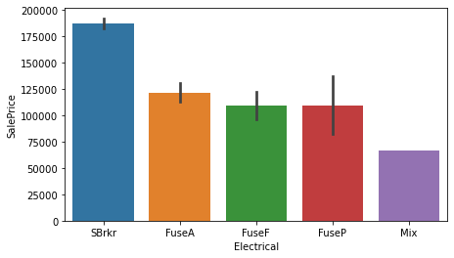
Electrical System
Electrical system of any house should be of good quality and durable. As this is one of the important part of any houses . All the electrical appliances are running on system been installed in house. And here with the help of bar plot we can see that houses which are having electrical system of Standard circuit breakers and Romex are having higher sales value. Here we can assume that this is one of the best electrical wiring considered in US

Slide 42
Floor Analysis

Slide 43
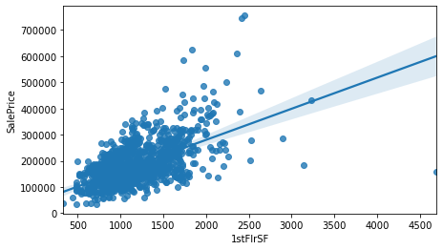
1st Floor Square Feet
In respect of sft we observed in fews columns above too that sft from 500 - 1500 sft are more in demand and same for 1st floor
here we can observe. Only few are there above 2000 sft which being sold out above rs.500000 . One more thing we can say that
with increase in sft price also increases which restrcit most of the buyers to purchase above 1500 sft though demand may be there or people may have willing to purchase but due to high budget they don't prefer. Also we can say one more thing as in US most of the families are neuclear and small so they don't require much spacious place. Here we need to see their demand as well as budget in which what they are preferring and why?

Slide 44

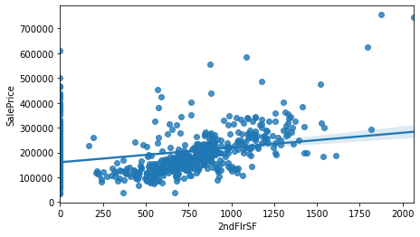
2nd Floor Square Feet
What we observed in 1st floow mainly aft starts from 500 - 1500 are more in demand while in 2nd floor there are no construction above 2000sft. And starting we can see that 250 sft are being sold.So construction on 1st floor are different from 2nd floow and so the demand are also less for this floor compare to 1st floor.

Slide 45

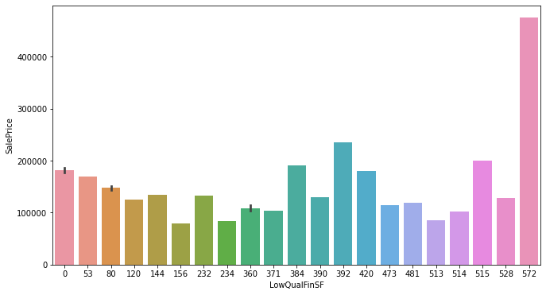
Low Quality finished Square Feet
Here we are analysing how much area been covered by low quality finishing . There is a number 572 given whose price is higher compare to others which is almost above 40000 that means this property number do have used good quality compare to others so the selling price is little higher.

Slide 46

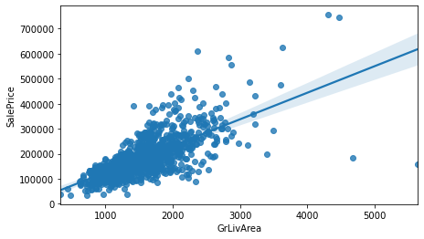
Area above ground living area in sft
Selling price graph is showing up only that means a positive relation between sft and price. With the increase in area price also increases simultaneously. There are some points which are out of line which we consider as outliers.

Slide 47
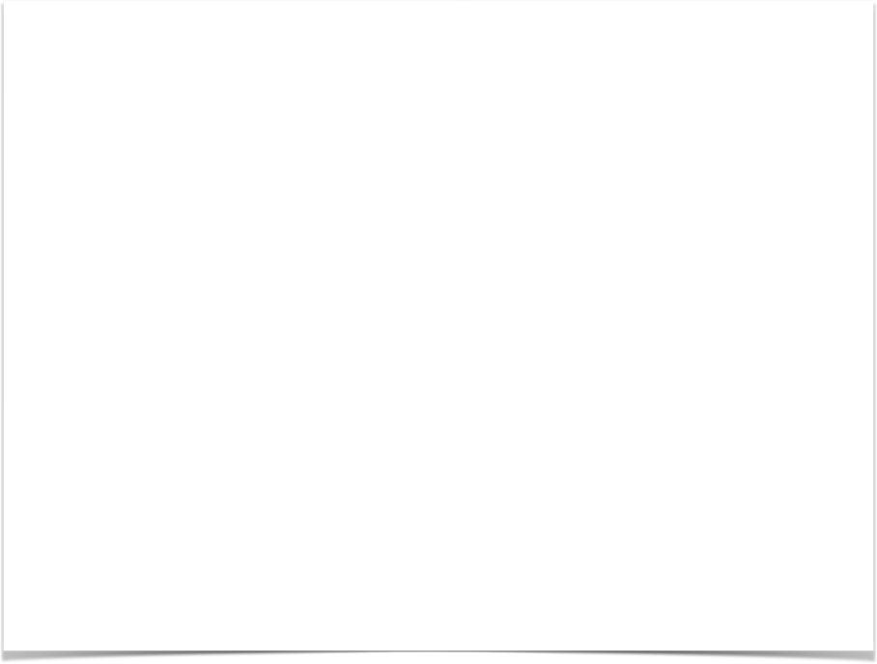
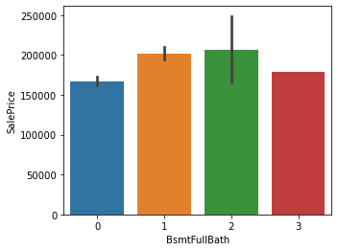
Basement Full Bathroom
If there are 2 full bathrooms in basement area then the price for the same is higher comparatively which is almost above 2 lac. While if having no bathroom then the price for the same is lower compare to others which are having this facility.

Slide 48

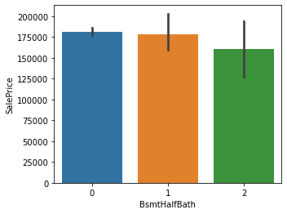
Basement Half Bathroom
Half bath in basement is not having so much variance in price if we compare from full bathroom as we can see that even with no bathroom price is same with having 1. While here we can see decrease in price if the number of bathroom increases as for 2 bathroom price is below 1.75 lac. Which means may be demand for half bathroom is less

Slide 49
Analysis based on interior facility of House

Slide 50
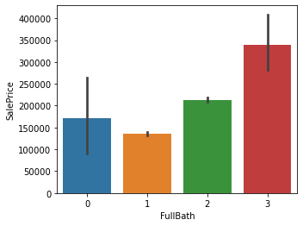
Full Bathroom above Grade
For full bathroom we seen the price was high even for basement if the number of bathroom were more and the same we can see for above grade too if the number of full bathroom are more price for the same is higher which is almost 3.5 lac while for no bathroom almost the price is half compare to 3 bathrooms. Which means that no of bathroom matters . We know that price increases with demand and here we can see the same

Slide 51

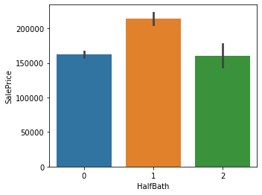
Half Bathroom above Grade
For half bathroom above grade more demand is for having only 1 as the selling price for the same is higher which is above 2 lac. Again we can say that demand for half bathroom is less and if there’s a demand then for less number of bathroom.

Slide 52

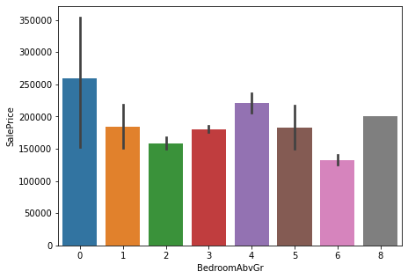
Bedroom above Grade
Bedroom above grade here are those which doesn’t have basement bedrooms. And mostly demand for this is less as we can see that number 0 which means no bedroom above grade is having higher selling price which is almost 2.5 lac. And lowest price we can see is for those which are having 6 bedrooms above grade.

Slide 53

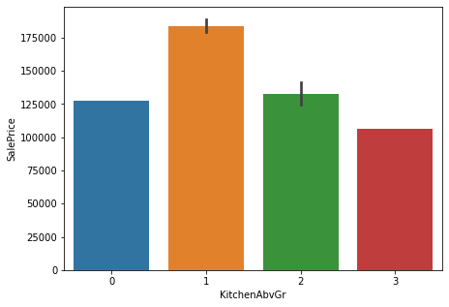
Kitchen above Grade
As bedroom above grade were having less demand and low selling price similarly checking whether the same condition is for kitchen or not. Here 1 kitchen being preferred most as the selling price for the same is almost 1.75 lac which is highest

Slide 54


Kitchen Quality
From very beginning we seen that come to quality always preferred is excellent and the price for the same is pretty high compare to other quality being used everywhere. Same in kitchen quality too we can see that excellent quality used material do have selling price almost near to 3.5 lac while fair quality is having very lw price which is almost 1 lac. Which means very less in demand in the market

Slide 55


Total Rooms above Grade excluding Bathroom
Room with 11 are having highest selling value which is almost above 3 lac which is excluding bathroom. While having only 2 rooms are having almost very low price even negligible so we can say that if the number of rooms will be more price will be high but after 11 as we seen that 12 and 14 rooms excluding bathroom price declined a lot. Means most preferred and demanding room with total number is 8

Slide 56

Home Functionality
Home functionality for typical selling price is high as deduction in this are almost nill while for major 2 we can see that selling highest reached are above 75K which is pretty less compare to typical functionality which almost reached above 1.75 lac. Deduction in home function will definitely have loss so price also varies accordingly

Slide 57


Number of Fireplaces
Higher the number of fireplace more the selling price is. With 3 fireplaces the price is almost 2.5 lac while having no fireplaces are having very less selling price which is almost 1.5 lac. Safety matters a lot and any of the houses should have this facility . Which in result we can see that houses with no such facility having very low rate in the market.

Slide 58
Analysis based on Garage Area

Slide 59


Garage Location
Garage which is having room above garage or we can say that in ground floor garage being build and above houses are built to stay having higher sales value which is obvious as person don’t have to go anywhere else to park there car or bike even it will be more safer. As we can see from bar plot that houses having garage apart from their place having very low value in market.

Slide 60


Year when Garage was Built
How old the garage price value for the same become that much lower. 1920 built garage selling value is almost 1 lac and so on as newer the garage built price will increase accordingly. Garage which were built after 2000 are having higher sales price which even reached upto 4 lac. This is obvious no one wants to invest in oldest property as renovation expenses will be added along with property value and also the older property will not be so durable compare to newer one so preference will definitely be newer one 1st if its fits the budget.

Slide 61


Interior Finishing of the Garage
Garage with complete work are more in demand and so the price is high which almost reached 2.5 lac followed by roughly finished garage which may fit to those whose budget is little low and can manageable. While Unfinished garage are having very low price. As if someone takes unfinished garage they have to work on that for use so what seller did by keeping lower selling price at least trying sell out those too.

Slide 62


Size of Garage in Car Capacity
Garage which are having capacity to have 3 cars in it are in high demand as the selling price for the same we can see reached upto 3 lac while with no car capacity is below 1 lac. And this type of garage those customer will only invest who doesn’t have car or budget is very low but wants to have garage space too.

Slide 63


Size of Garage in Square feet
Mostly garage in demand with space from 200 - 600 sft where we can see that price increases with the size of the garage. Even for 800 sft too there are higher sale value but here we can see at some point there are few data points which means either due to higher price sale for this bigger size is less or people preferring upto 600 sft most as it fits the budget simultaneously space is also not so small compare to 800 sft

Slide 64


Garage Quality
Quality of garage with excellent material being used and other factors too considered to be wonderful are having higher price value which is almost 3 lac while with poor quality do have very low price which is almost 1 lac

Slide 65


Garage Condition
Condition of garage we seen that for good and average is having higher selling price. For this may be the reason is customer sees the quality of material being used while constructing the same. And if the material used and quality for the same is of higher quality customer preferring good an average condition for the same.

Slide 66


Paved Driveway
If the paved driveway is there near the property that property rate is high and the selling price is almost reached above 1.75 lac. While the property not adjacent to paved driveway having lowest selling price which is below 1.25 lac.

Slide 67


Wood Deck area in Squarefeet
Mainly wood deck area covered almost from 50 - 300 sft which cost around 3 lac highest. There are few outliers in this column which we need to remove

Slide 68


Open Porch area in Squarefeet
Open porch area which is open location in front or back of house mainly we can see that area covered within 150 sft being sold at higher price which is upto 3 lac

Slide 69


Enclosed Porch area in Squarefeet
Enclosed porch people are not prefering much to have in bigger space as we can see with the help of regplot that within
300 sft that too are not much in demand as the space preference is less so equally the price are also ranging between 1 - 2 lac maximum

Slide 70


Three Season Porch area in Squarefeet
As we can see the trend of 3 Season porch which we can say anenclosed room with lots of windows usually used in summer, spring and fall but not in winter by residents there.
For small space house is 153 sft which is more in demand and for bigger space house we can say
that 304 sft is in more demand as price for these two are almost same i.e., upto 4 lac being invested to have this portion

Slide 71


Screen Porch area in Squarefeet
screen porch are mainly used in exterior of the house to cover windows or house so that no insect or any undesirable objects
enters the house. Here we can see that from 100 - 200 sft been mainly used for this kind of usage

Slide 72


Pool area in Squarefeet
Pool area mainly prefered is 555 sft which is having higer selling price compare to other area

Slide 73


Value of Miscellaneous Feature
Value for miscellenous feature we can say for some like 1150, 2500 sft areas ara having price upto 2.5 lac.

Slide 74


Month Sold
This column gives us the insight that which month the sale is high and we can see that 9th which is september month mostly the sale is in peak
and price also varies with the month. Lowest sale we can observe in the month of April.

Slide 75


Year Sold
Highest selling price for house we can see was in the year 2007 after that though the price being constant for 2008,2009,2010 but we can see the diminishing
price for properties after 2007 which shows that property rate being decreased after 2007 and after that it's constant means not much change in price

Slide 76


Sale Type
Selling piece is higher in the market for newly constructed houses and contract with 15% down payment regular terms. Newly constructed will obviously have higher price as in market everybody demand for the same and 15% down payment will be convenient for most of the buyers so these types of houses are having higher selling value.

Slide 77


Condition of Sale
Here with the help of bar plot we get the insight that mainly for houses which are in under construction condition i.,e partial finished houses are having higher selling value. There may two reason for having higher value as under construction houses any one can modify according to their choice and need. Another reason we can say that after completion a person will get newly constructed house at low rate compare to finished house

Slide 78
Conclusion
Everybody around the globe wants to have their own house, so the real estate business is one of demanding and high generating revenue towards the
economy of country. And as more demanding and high generating revenue business lot many companies are in this domain. Competition is too high due to
lot many competitors are there in the market. Companies uses data scientist to have knowledge of trend going on in market, what strategy to follow, how to increase overall revenue and earn good profit, what is the customer preference and how prices varies with the time. These are the few factor
which every company focuses to establish as a successful real estate business. Here data scientist by using their domain knowledge can predict whether
investing in that particular market is profitable or not.We are doing project for one of the real estate company I.e., surprise housing who wants to enter to
US country to establish their real estate business, and for this they gathered data from sale of houses in Australia , with the help of which they can come to conclusion what trend going on in market by looking after the previous sales information regarding other properties in that particular country.
By looking after the previous data came across that property rate varies to lot many features , such as exterior and interior quality of house, condition of
house, how old the property is, condition and quality of over all extra facilities such as garage, porch, pool, fire , electricity, heating, what kind of road and
how wide is the road adjacent to property, floor wise also rate varies, what sft being used as wooden floor, how much area been used as open space, etc. If any customer do have floor preference there also price varies. What sft been preferred by the customer mostly , and whether price for those
area are same whenever sold. All these factors were important while selling the property. Also we came across that what is the demand of customer by
looking after the price of property being sold mostly. As we know that buying property is one of the important and sentimental decision for most population
so they go through every aspect to have the best for themselves. As a property consultant company should always consider what a customer demand and what is their budget, and if both are eligible then how to convince them to purchase from a particular agent. With the help of machine
learning we came across that this data was having lot many missing values, skewness and outliers which we were suppose to treat. Now as a data scientist
treated all the missing values using mean and mode for continuous and categorical column respectively. Later done feature engineering as there were few
column which was in object form. Using label encoding converted all the object data type to integer form. After fixing everything trained model to have prediction using 5 algorithm , just to check which algorithm performs best. In which Random Forest classifier were the best performing model with
highest score of 88% . Later did hyperparameter tuning to improve more accuracy, 1% increment being observed in score.

